Slide 1




Global Classroom (ITA & TEC)

Slide 2


Slide 3
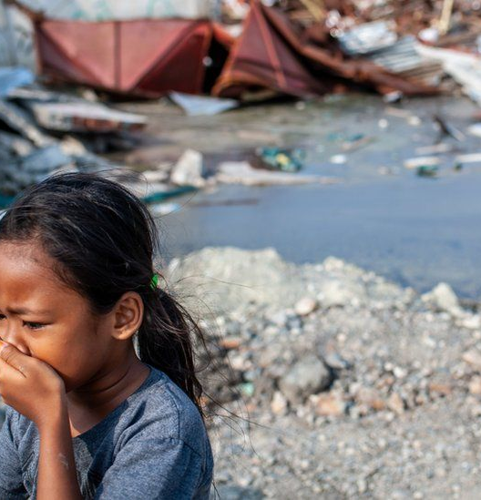
Goal of Collaboration
The collaboration focuses on developing the students the sense of cooperation needed to solve a complex problem.
The problem to be answered is how to provide an efficient and secure environment to send a distress message when a natural disaster occurs (earthquake, flood, etc.).

Slide 4
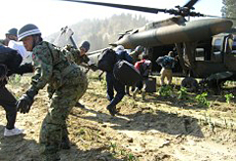
SDG’s goals
The sustainable development goal is the “Industry, Innovation, and Infrastructure” and “Sustainable Cities and Communities,” where the group will work to build a resilient infrastructure when there is a natural hazard.

Slide 5


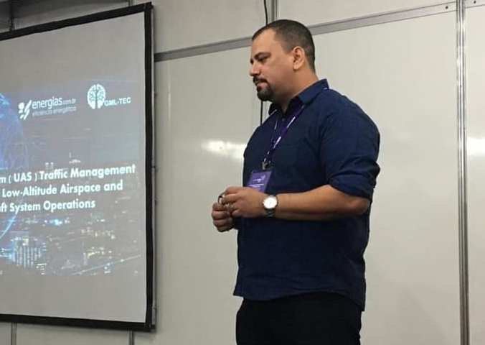
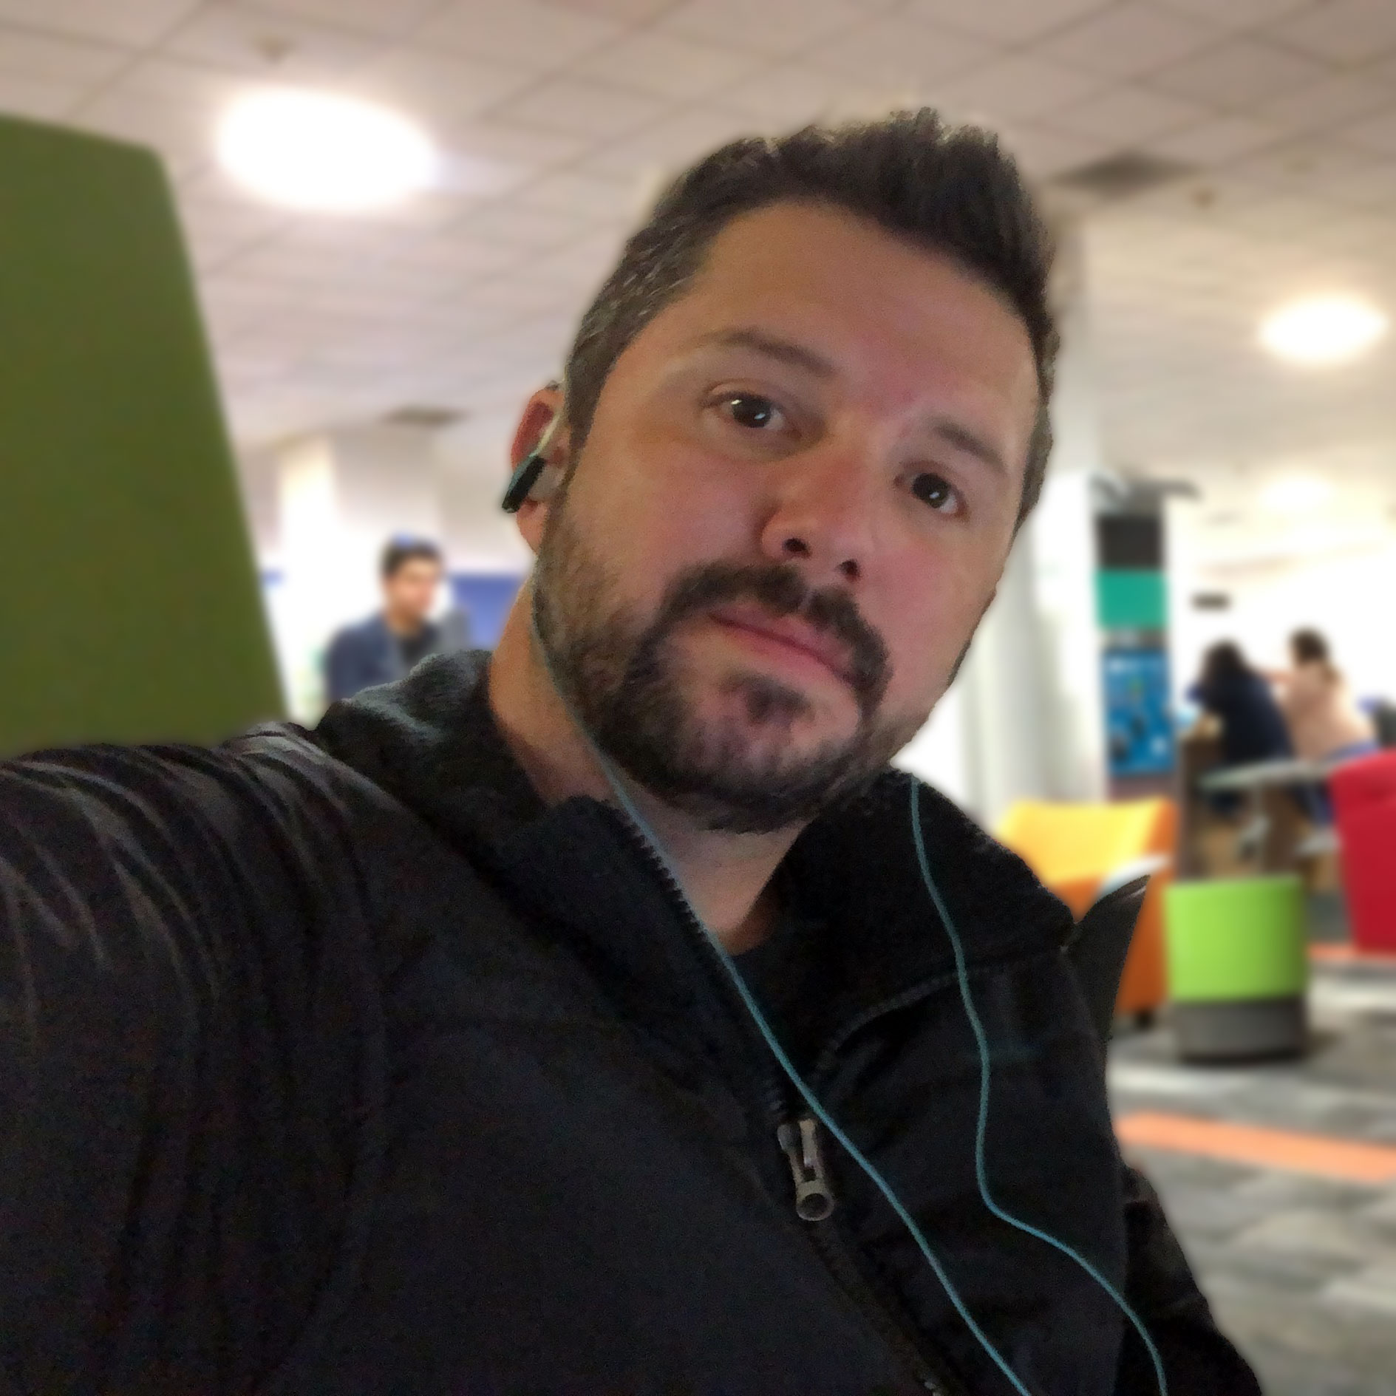
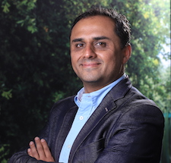
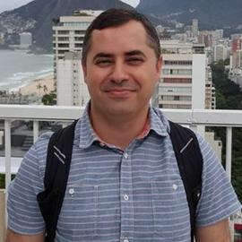
Professors
Alexandre Barreto
Luis José González
Luis Yépez Pérez
Cesar A. C. Marcondes

Slide 6
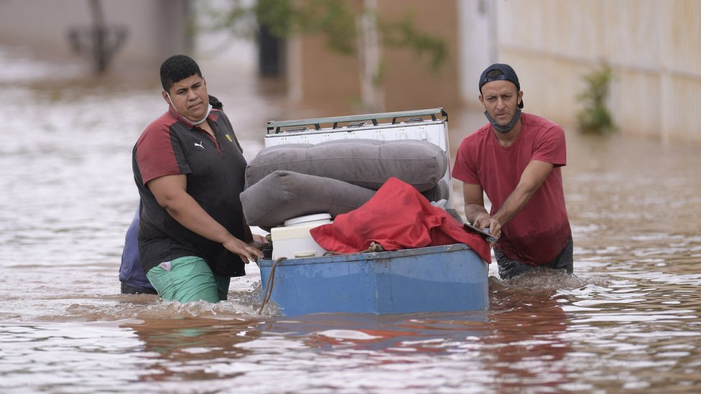
Scenario - Flood
Drones Operations
No Telecommunications
Raspberry Devices
OR
Android
No C2 Resources

Slide 7
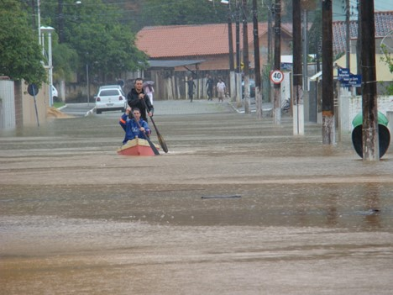
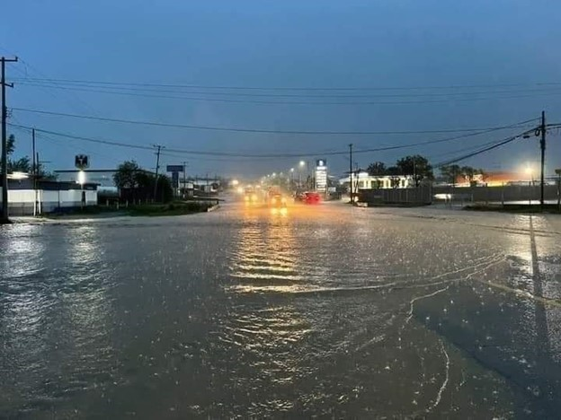
Scenario - Flood
No Telecommunications
Drones Operations
No C2 Resources
Android

Slide 8
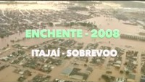

Slide 9



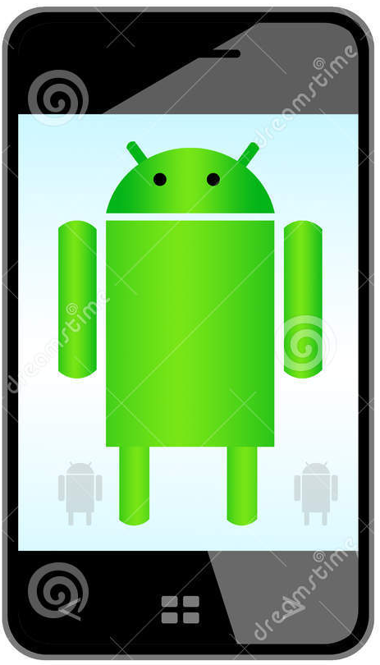

Flood Scenario
Location
Risk
Severity
Edge
MQQT/REST
MQQT/REST
Cloud
MQQT
MQQT
MQQT
GPS Position
Severity
GPS Position
Severity
Sensors

Slide 10





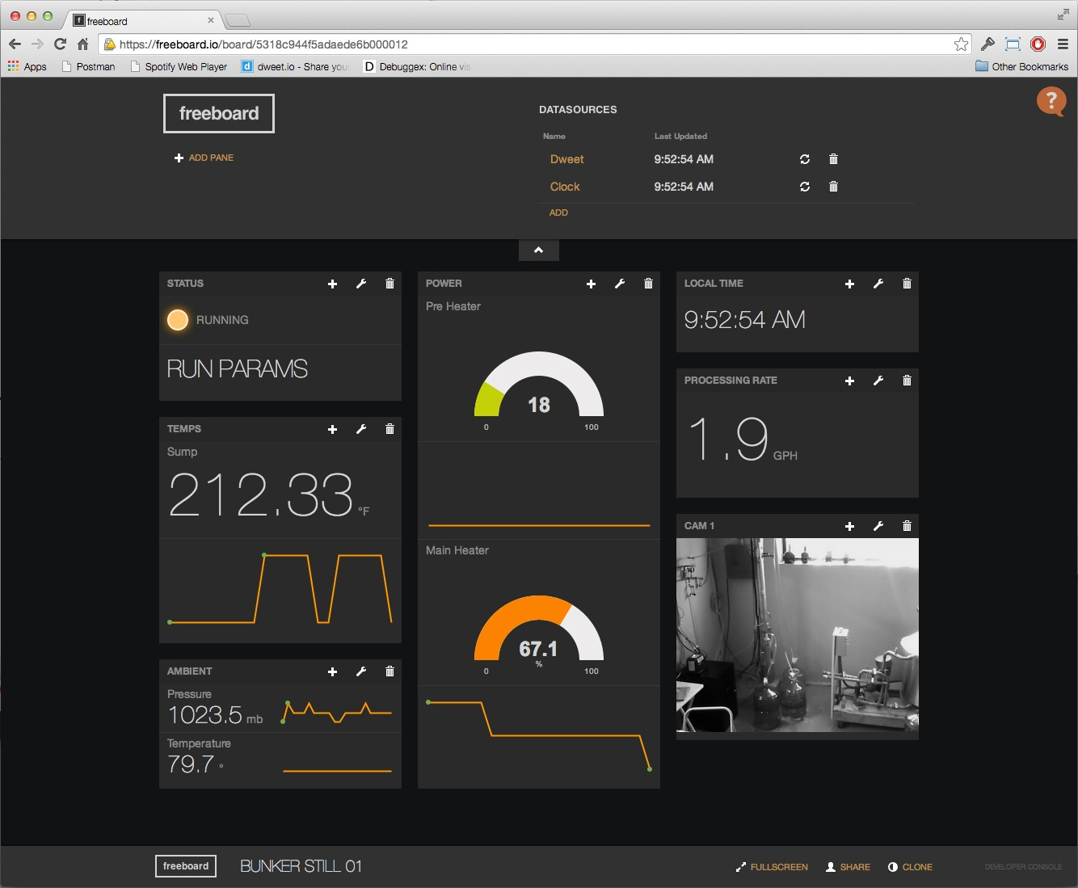
Cloud
Edge
Location
Risk
Severity
GPS Position
Severity
GPS Position
Severity
Sensors

Slide 11
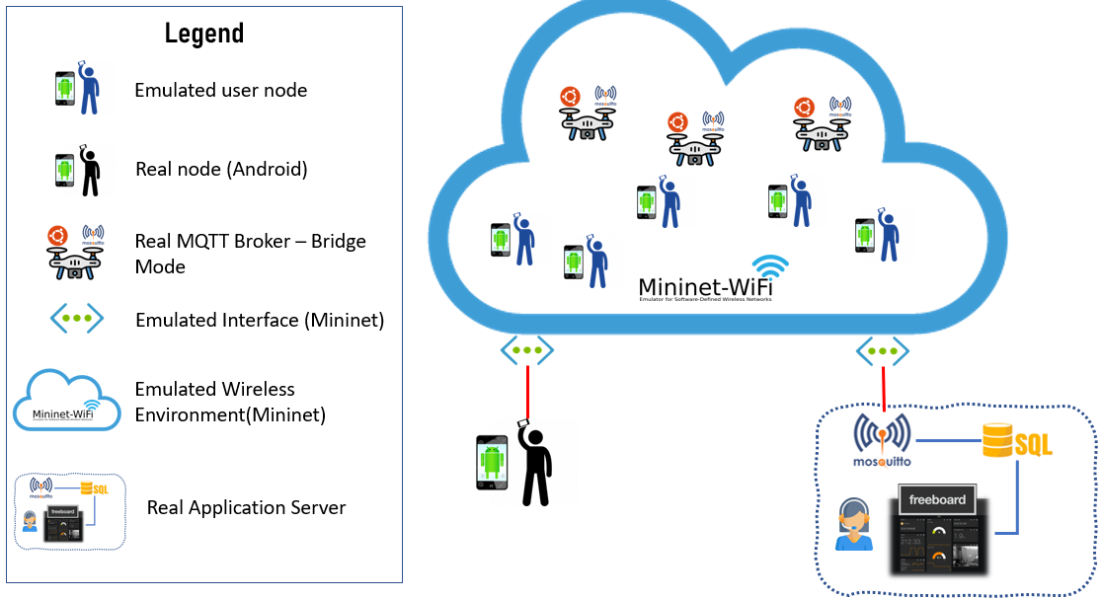

Slide 12
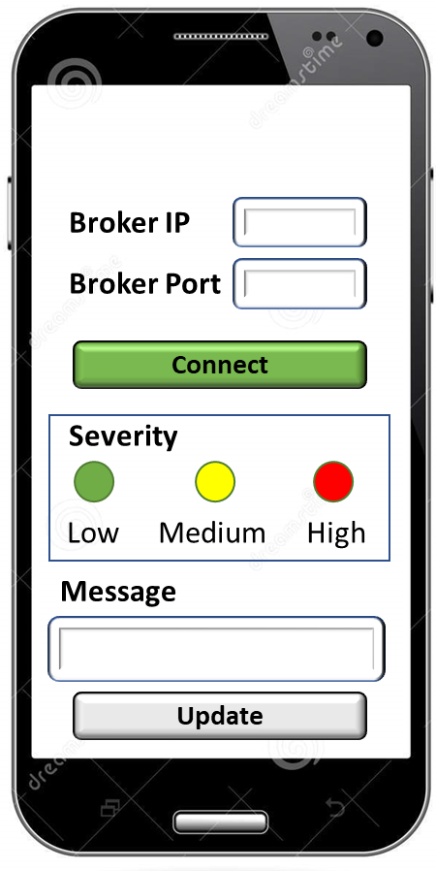


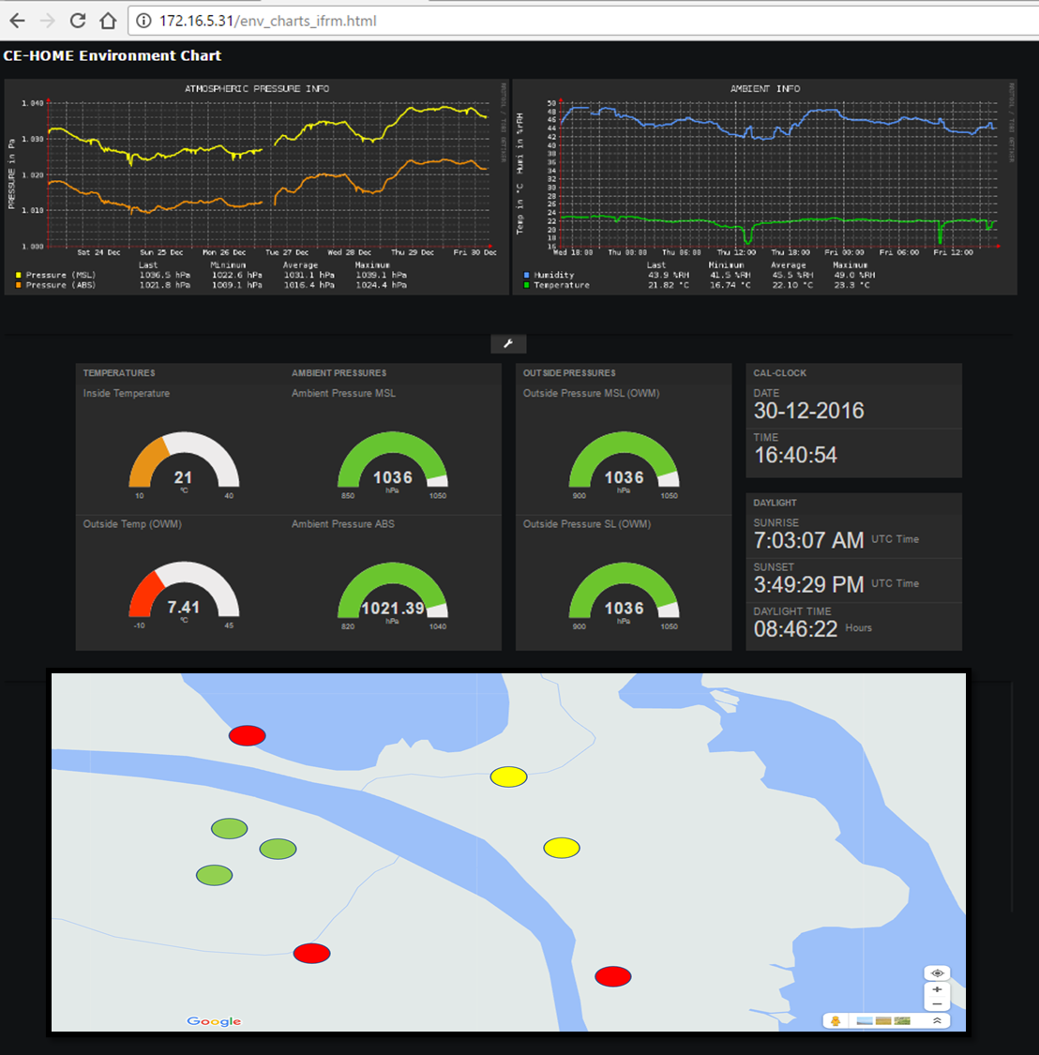

1
1
Emulation Gateway
CLOUD STAGE
EDGE & GATEWAY STAGE
Internet Gateway
SENSORS AND ACTUATORS STAGE
real MQTT device flow
emulated MQTT device flow

Slide 13
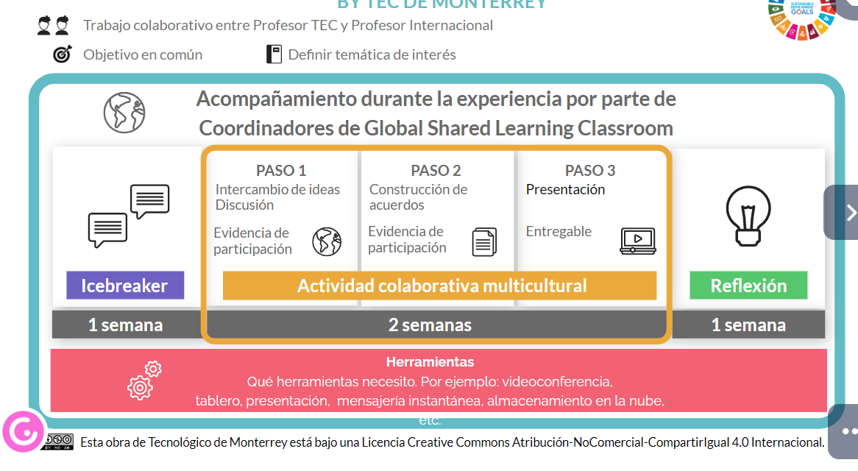

Slide 14
Agenda
Week 1: Icebreaker Video & Reply to the peers
Week 2: Project Setup
Week 3: Client & Edge Stage
Week 4: Cloud Stage
Week 5: Final Presentation & Reflection

Slide 15
Final Presentation
What is the problem? (3 minutes): In this part, the student needs to explain the situation the system plans to solve using external references (like news, papers, etc.). It is essential that the question related to the “why” needs to be answered. Try to motivate the audience to continue to watch your video.
Technical Architecture of Solution (8 minutes): The student needs to explain the technical architecture. It is essential to identify the system’s border (what is inside and outside) and use formal language (like package, system UML diagram, or SysML).
How to configure the solution (1 minute): It is essential to cite the issues about how to compile, configure, and run your solution. Remember, one of the items required to deliver is the README in the git. The idea is to explain the setup and some tips for compiling the code.
Demo of System (until 8 minutes): This part is essential to demonstrate all the system's functionalities.

Slide 16
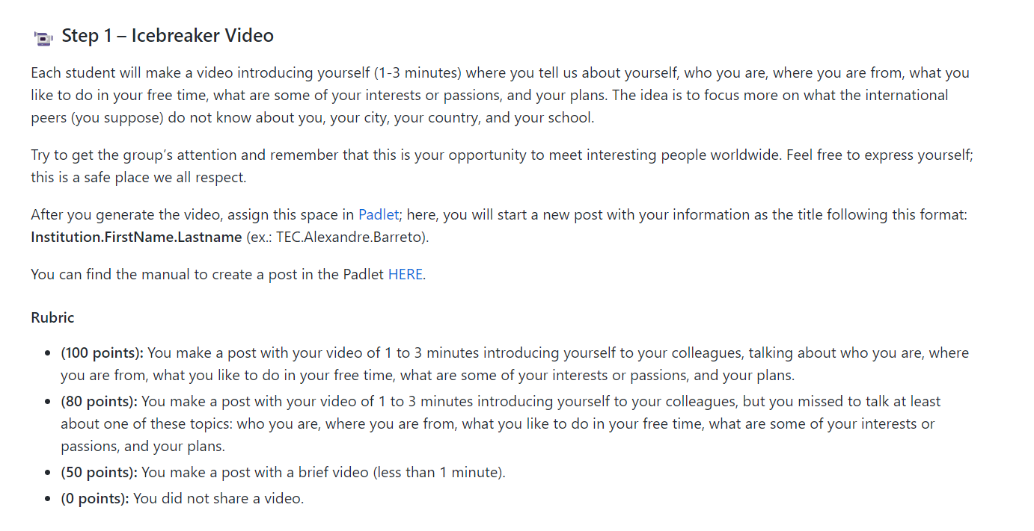
How do we evaluate the activities?

Slide 17

https://github.com/kabartsjc/gsl-iot-2022

Slide 18
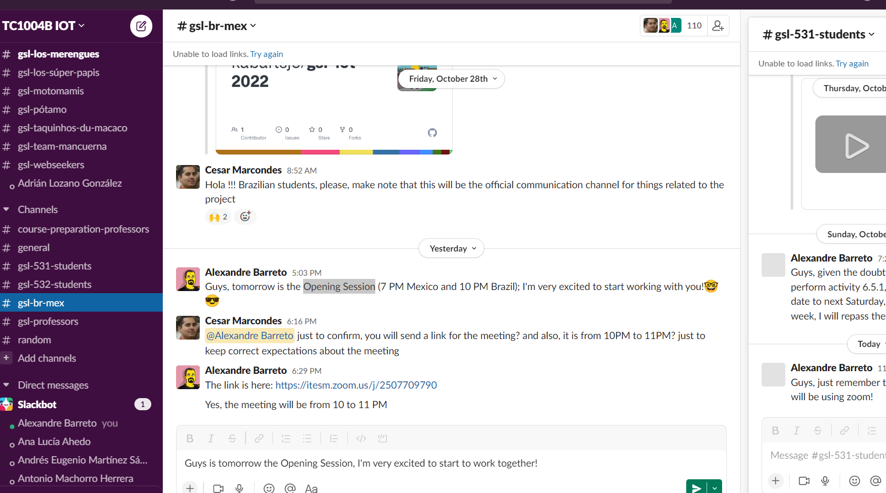


Slide 19
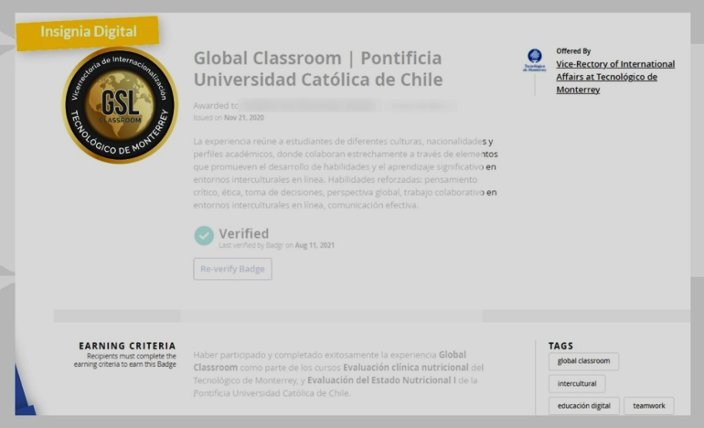
Digital Badge
Participation in the icebreaker.
Participation in Team Activities.
Participation in the Reflection.
Obtain 80% of the total of the Global Classroom grade.

Slide 20
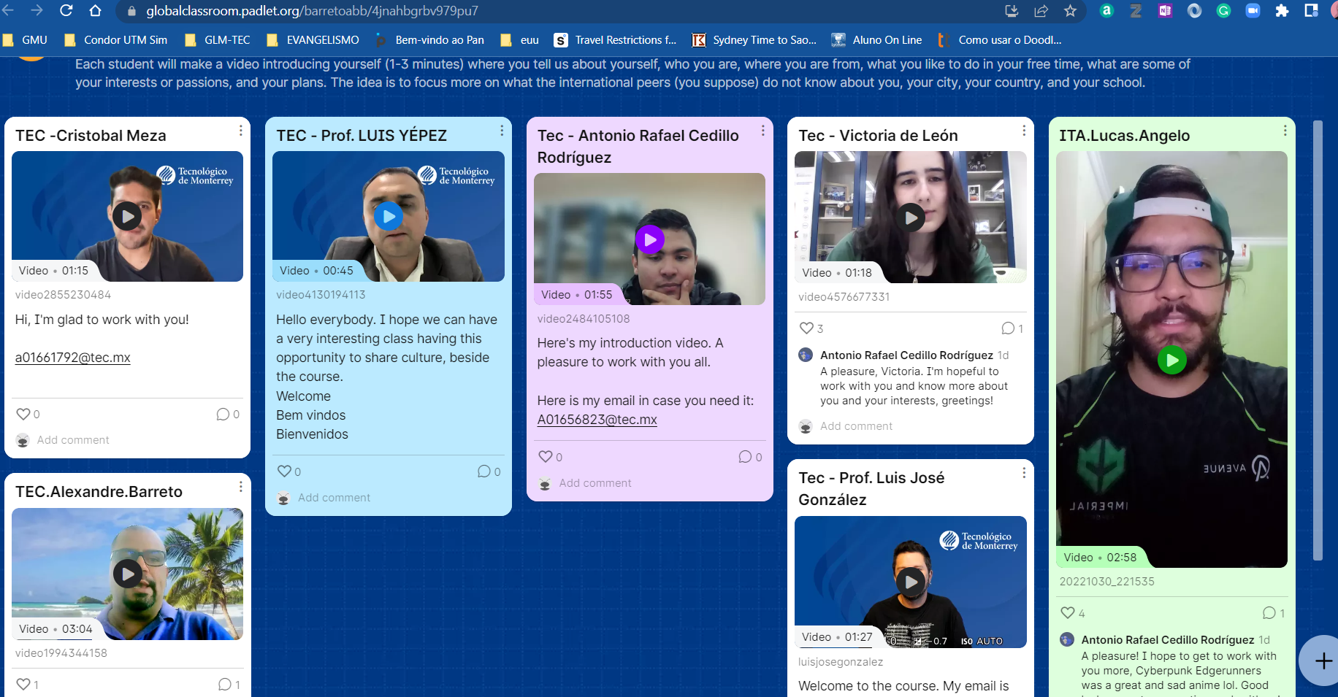
Icebreaker Activity
video introducing yourself (1-3 minutes)
tell about yourself, who you are, where you are from, what you like to do in your free time, what are some of your interests or passions, and your plans.
The idea is to focus more on what the international peers (you suppose) do not know about you, your city, your country, and your school.
reply to at least two other students (from the other country)
https://globalclassroom.padlet.org/barretoabb/4jnahbgrbv979pu7

Slide 21

Next steps
Read the GitHub website
Talk if your peers
Perform the icebreaker activity
Answer the survey
https://calendly.com/d/g6f-7r8-nzq/what-day-would-you-like-to-have-advice

Slide 22
Global Classroom (ITA & TEC)

